Slide 1

Classification: Alternative Techniques
Dr. Meng Qu
Rutgers University

Slide 2
Classification: Alternative Techniques
Rule-based Classifier

Slide 3
Rule-Based Classifier
Classify records by using a collection of “if…then…” rules
Rule: (Condition) → y
  where
    Condition is a conjunctions of attributes
    y is the class label
  LHS: rule antecedent or condition
  RHS: rule consequent
  Examples of classification rules:
    (Blood Type=Warm) ∧ (Lay Eggs=Yes) → Birds
    (Taxable Income < 50K) ∧ (Refund=Yes) → Evade=No

Slide 4
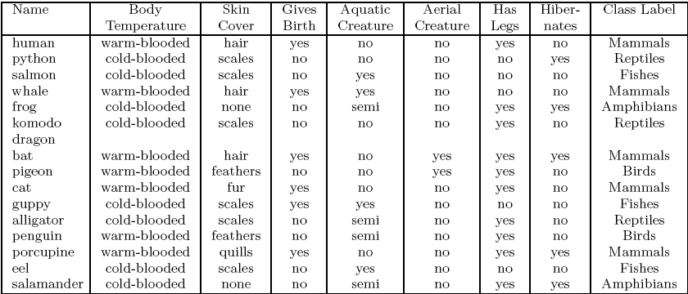
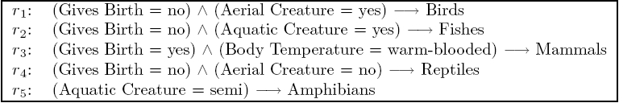
Rule-based Classifier (Example)

Slide 5

Application of Rule-Based Classifier
A rule r covers an instance x if the attributes of the instance satisfy the condition of the rule
The rule r1 covers a hawk => Bird
The rule r3 covers the grizzly bear => Mammal

Slide 6
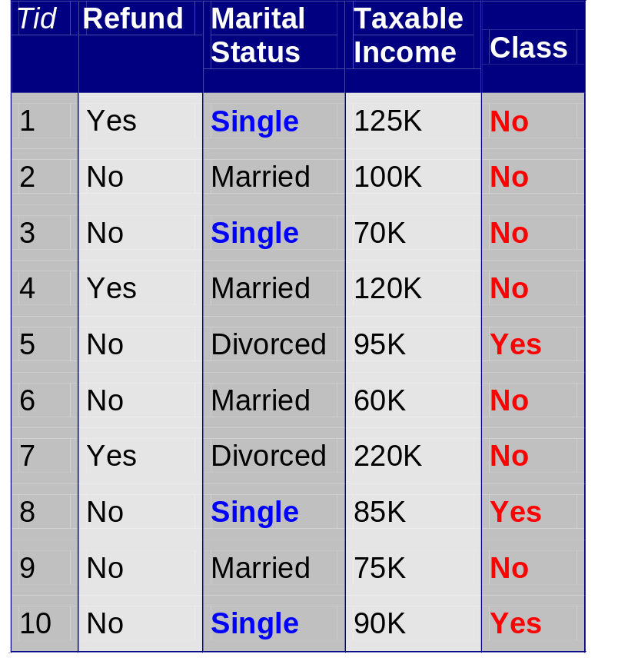
Rule Coverage and Accuracy
Coverage of a rule:
  Fraction of records that satisfy the antecedent of a rule
Accuracy of a rule:
  Fraction of records that satisfy both the antecedent and consequent of a rule
(Status=Single) → No
Coverage = 40%, Accuracy = 50%

Slide 7
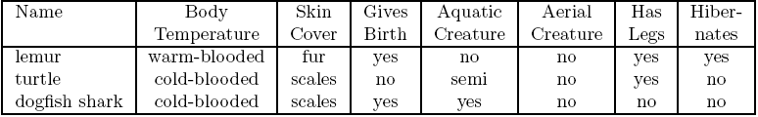
How does Rule-based Classifier Work?
A lemur triggers rule r3, so it is classified as a mammal
A turtle triggers both r4 and r5
A dogfish shark triggers none of the rules

Slide 8
Characteristics of Rule-Based Classifier
Mutually exclusive rules
  Classifier contains mutually exclusive rules if the rules are independent of each other
  Every record is covered by at most one rule
Exhaustive rules
  Classifier has exhaustive coverage if it accounts for every possible combination of attribute values
  Each record is covered by at least one rule

Slide 9
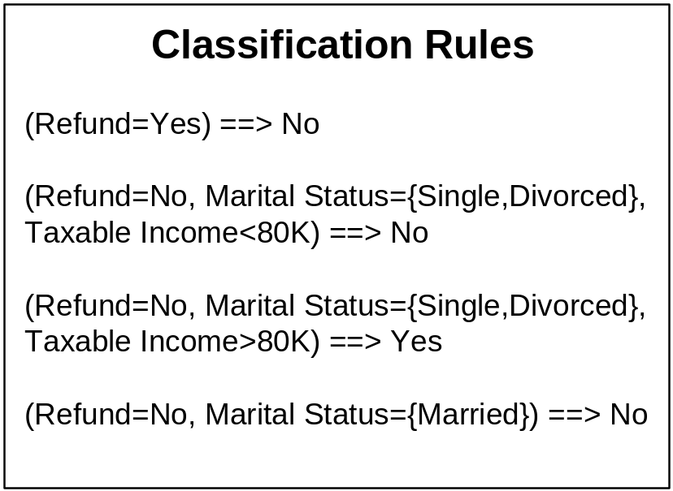
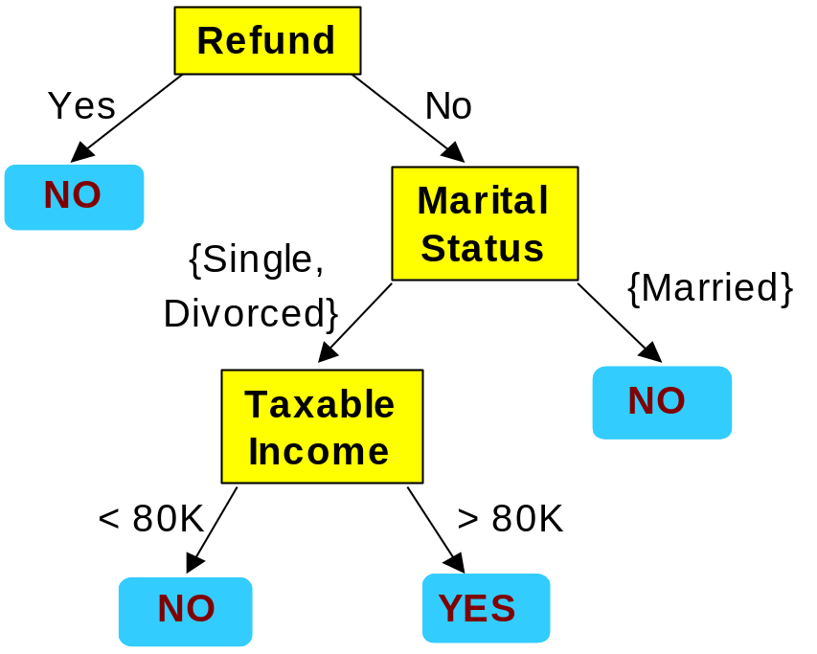
From Decision Trees To Rules
Rules are mutually exclusive and exhaustive
Rule set contains as much information as the tree

Slide 10
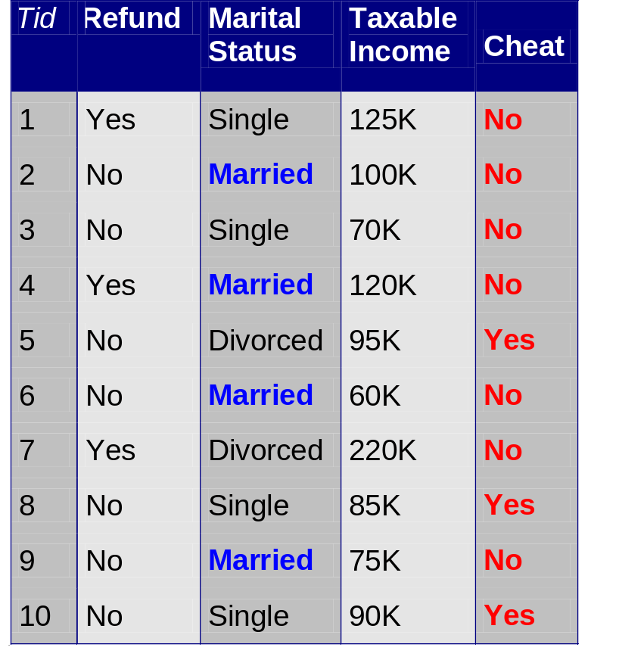
Rules Can Be Simplified
Initial Rule: (Refund=No) ∧ (Status=Married) → No
Simplified Rule: (Status=Married) → No

Slide 11
Effect of Rule Simplification
Rules are no longer mutually exclusive
  A record may trigger more than one rule
  Solution?
    Ordered rule set
    Unordered rule set – use voting schemes
Rules are no longer exhaustive
  A record may not trigger any rules
  Solution?
    Use a default class

Slide 12
Ordered Rule Set
Rules are rank ordered according to their priority
  An ordered rule set is known as a decision list
When a test record is presented to the classifier
  It is assigned to the class label of the highest ranked rule it has triggered
  If none of the rules fired, it is assigned to the default class

Slide 13
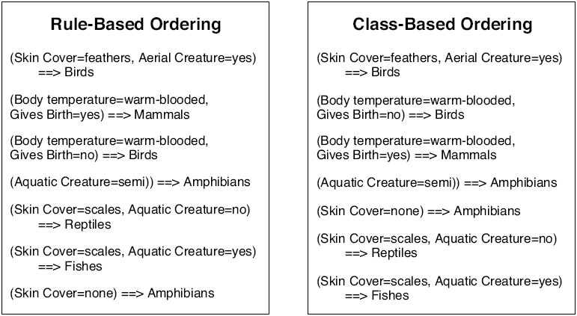
Rule Ordering Schemes
Rule-based ordering
  Individual rules are ranked based on their quality/priority
Class-based ordering
  Rules that belong to the same class appear together

Slide 14
Building Classification Rules
Direct Method:
    Extract rules directly from data
    e.g.: RIPPER, CN2, 1R, and AQ
Indirect Method:
    Extract rules from other classification models (e.g.
    decision trees, neural networks, SVM, etc).
    e.g: C4.5rules

Slide 15
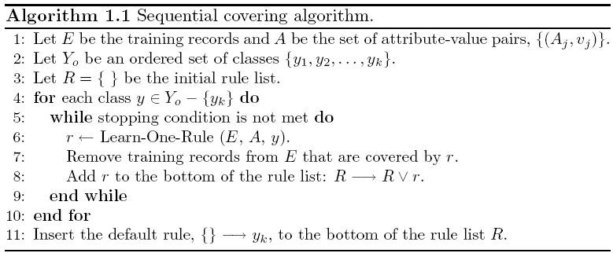
Direct Method: Sequential Covering

Slide 16
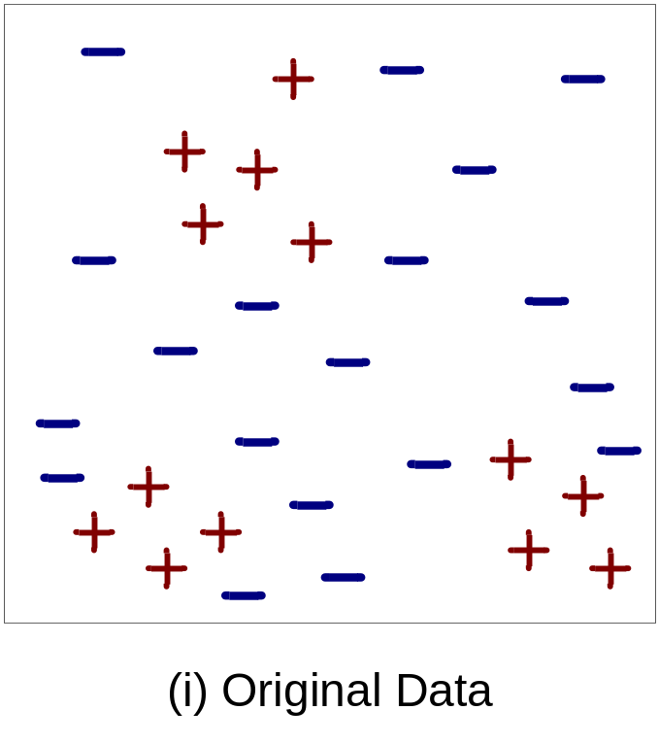
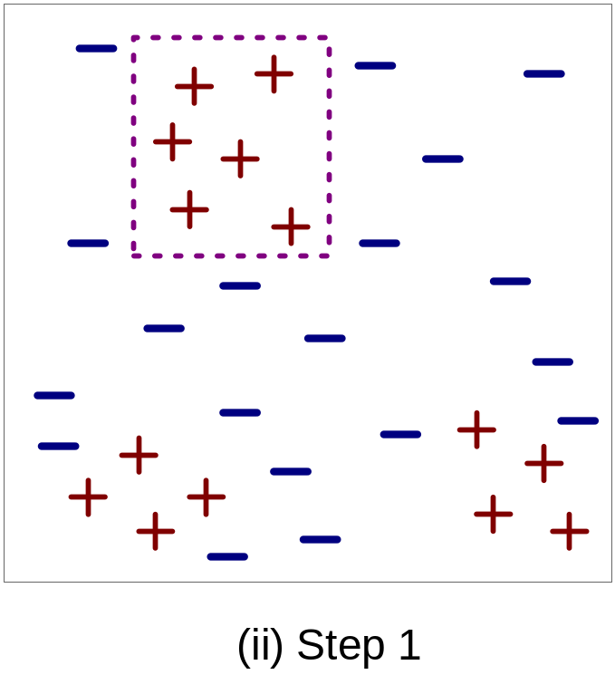
Example of Sequential Covering

Slide 17
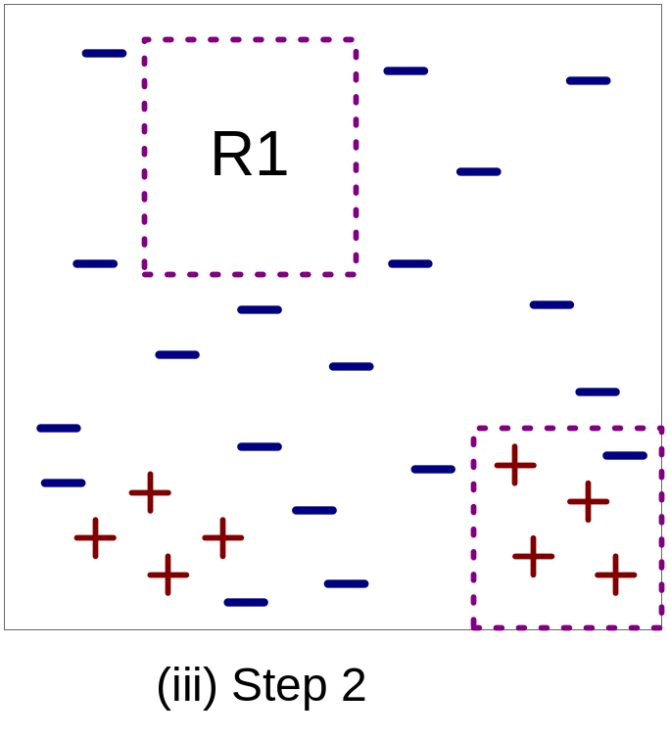
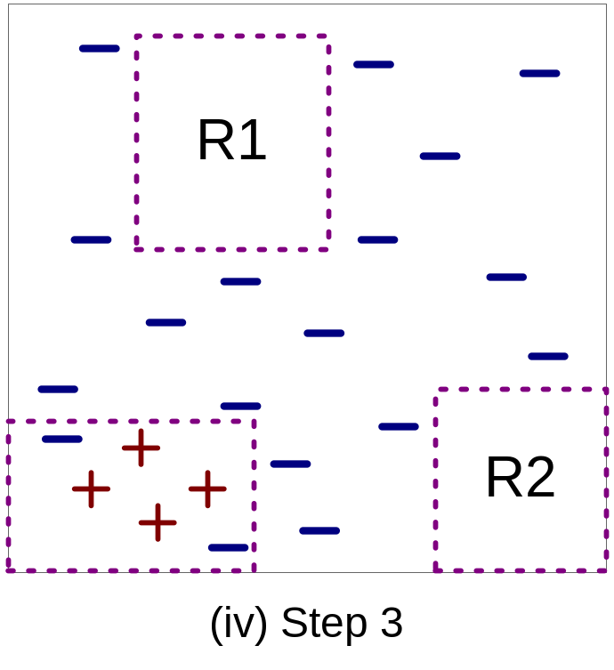
Example of Sequential Covering…

Slide 18
Aspects of Sequential Covering
Rule Growing
  Rule evaluation
Instance Elimination
Stopping Criterion
Rule Pruning

Slide 19
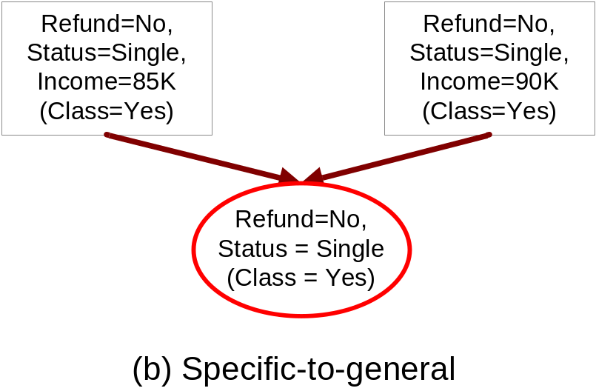
Rule Growing
Two common strategies
Yes: 3
{ }
No: 4
...
Refund=
Status =
Status =
Status =
Income
No
Single
Divorced
Married
> 80K
Yes: 3
Yes: 2
Yes: 1
Yes: 0
Yes: 3
No: 4
No: 1
No: 0
No: 3
No: 1
(a) General-to-specific

Slide 20
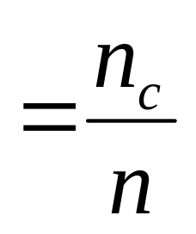
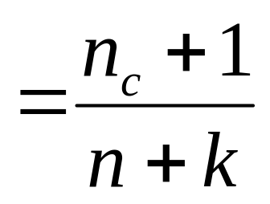
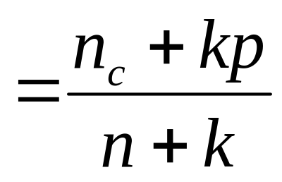
Rule Evaluation
Evaluation metric determines which conjunct should be added during rule growing
  Accuracy
  Laplace
  M-estimate
n : Number of instances covered by rule
n_{c} : Number of instances of class c covered by rule
k : Number of classes
p : Prior probability

Slide 21
Rule Growing (Examples)
CN2 Algorithm:
  Start from an empty conjunct: {}
  Add conjuncts that minimizes the entropy measure: {A}, {A,B}, …
  Determine the rule consequent by taking majority class of instances covered by the rule
RIPPER Algorithm:
  Start from an empty rule: {} => class
  Add conjuncts that maximizes FOIL’s information gain measure:
    R0: {} => class (initial rule)
    R1: {A} => class (rule after adding conjunct)
    Gain(R0, R1) = t [ log (p1/(p1+n1)) – log (p0/(p0 + n0)) ]
    where t: number of positive instances covered by both R0 and R1
    p0: number of positive instances covered by R0
    n0: number of negative instances covered by R0
    p1: number of positive instances covered by R1
    n1: number of negative instances covered by R1

Slide 22
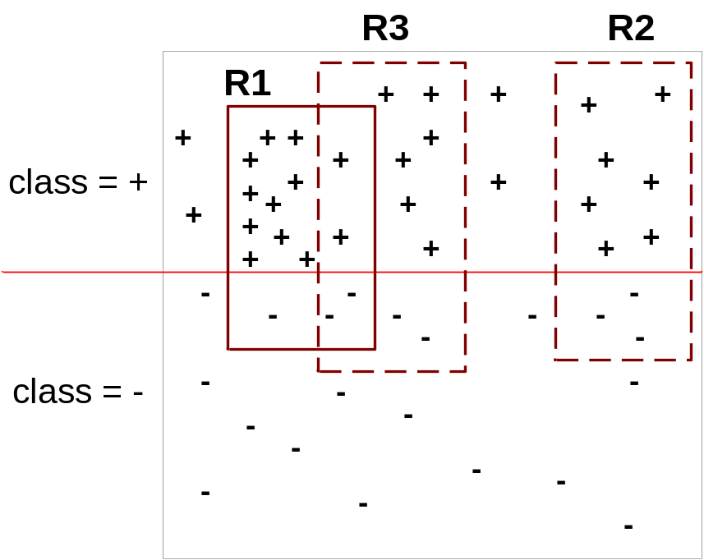
Instance Elimination
Why do we need to eliminate instances?
  Otherwise, the next rule is identical to previous rule
Why do we remove positive instances?
  Ensure that the next rule is different
Why do we remove negative instances?
  Prevent underestimating accuracy of rule
  Compare rules R2 and R3 in the diagram

Slide 23
Stopping Criterion and Rule Pruning
Examples of stopping criterion:
  If rule does not improve significantly after adding conjunct
  If rule starts covering examples from another class
Rule Pruning
  Similar to post-pruning of decision trees
  Example: using validation set (reduced error pruning)
    Remove one of the conjuncts in the rule
    Compare error rate on validation set before and after pruning
    If error improves, prune the conjunct

Slide 24
Summary of Direct Method
Initial rule set is empty
Repeat
  Grow a single rule
  Remove Instances covered by the rule
  Prune the rule (if necessary)
  Add rule to the current rule set

Slide 25
Direct Method: RIPPER
For 2-class problem, choose one of the classes as positive class, and the other as negative class
  Learn the rules for positive class
  Use negative class as default
For multi-class problem
  Order the classes according to increasing class prevalence (fraction of instances that belong to a particular class)
  Learn the rule set for smallest class first, treat the rest as negative class
  Repeat with next smallest class as positive class

Slide 26
Direct Method: RIPPER
Rule growing:
  Start from an empty rule: {} → +
  Add conjuncts as long as they improve FOIL’s information gain
  Stop when rule no longer covers negative examples
  Prune the rule immediately using incremental reduced error pruning
  Measure for pruning: v = (p-n)/(p+n)
    p: number of positive examples covered by the rule in
    the validation set
    n: number of negative examples covered by the rule in
    the validation set
  Pruning method: delete any final sequence of conditions that maximizes v

Slide 27
Direct Method: RIPPER
Building a Rule Set:
  Use sequential covering algorithm
    Grow a rule to cover the current set of positive examples
    Eliminate both positive and negative examples covered by the rule
  Each time a rule is added to the rule set, compute the new description length
    stop adding new rules when the new description length is d bits longer than the smallest description length obtained so far

Slide 28
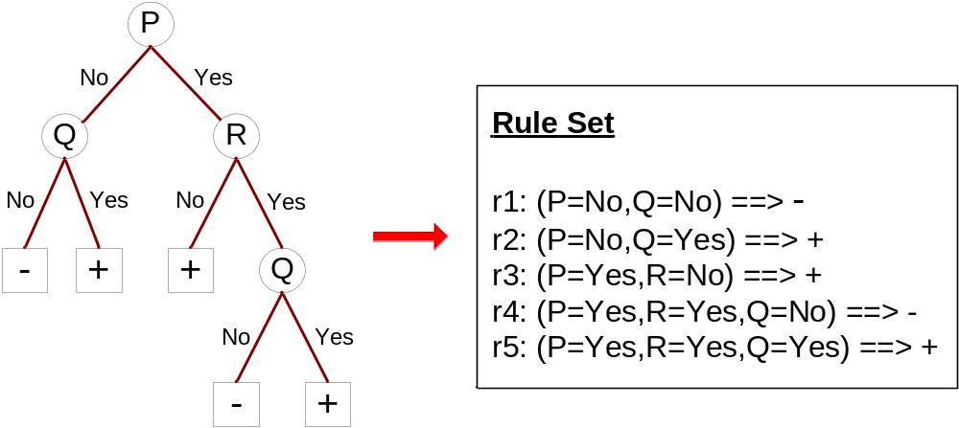
Indirect Methods

Slide 29
Indirect Method: C4.5rules
Extract rules for every path from root to leaf nodes
For each rule, r: A → y,
  consider alternative rule r’: A’ → y where A’ is obtained by removing one of the conjuncts in A
  Compare the pessimistic error rate for r against all r’s
    Prune if one of the r’s has lower pessimistic error rate
  Repeat until pessimistic error rate can no longer be improved

Slide 30
Indirect Method: C4.5rules
Use class-based ordering
  Rules that predict the same class are grouped together into the same subset
  Compute total description length for each class
  Classes are ordered in increasing order of their total description length

Slide 31
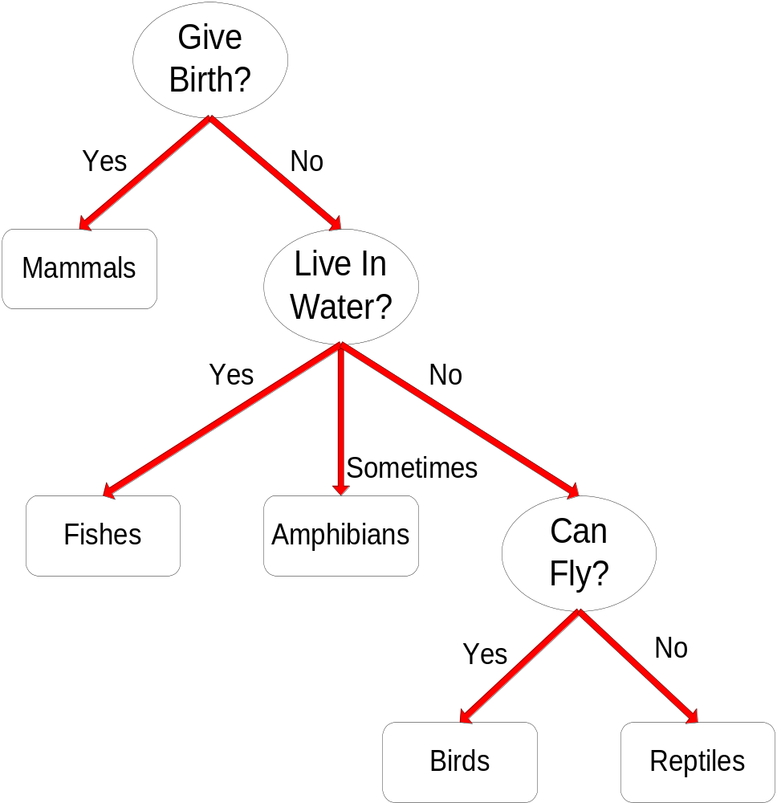
Example
C4.5rules:
(Give Birth=No, Can Fly=Yes) → Birds
(Give Birth=No, Live in Water=Yes) → Fishes
(Give Birth=Yes) → Mammals
(Give Birth=No, Can Fly=No, Live in Water=No) → Reptiles
( ) → Amphibians

Slide 32
Characteristics of Rule-Based Classifiers
As highly expressive as decision trees
Easy to interpret
Easy to generate
Can classify new instances rapidly
Performance comparable to decision trees

Slide 33
Classification: Alternative Techniques
Instance-Based Classifiers

Slide 34
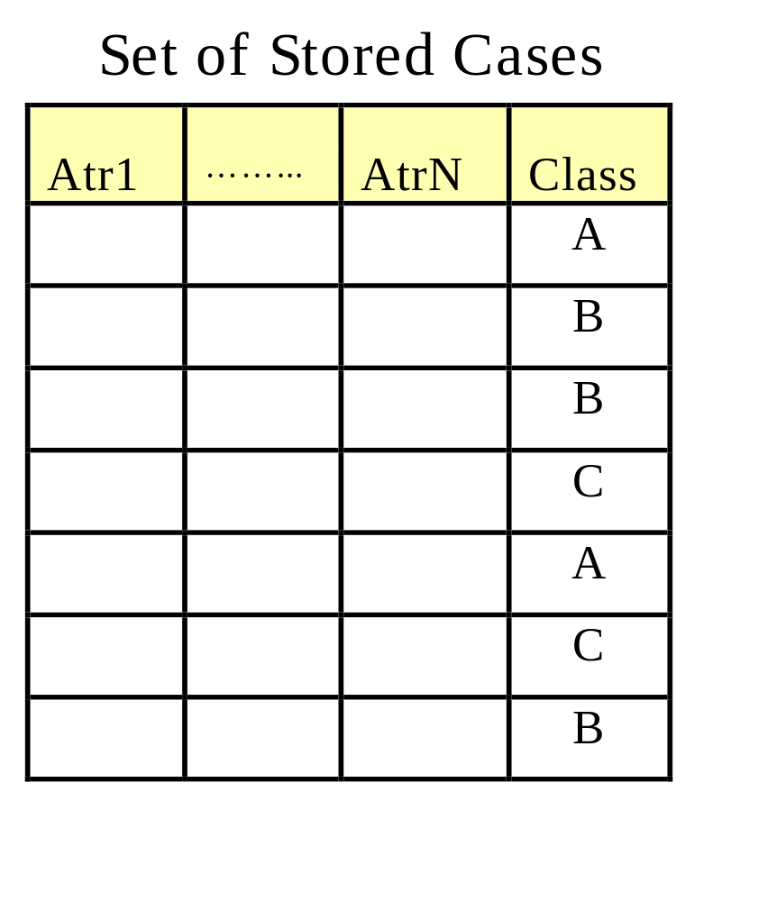
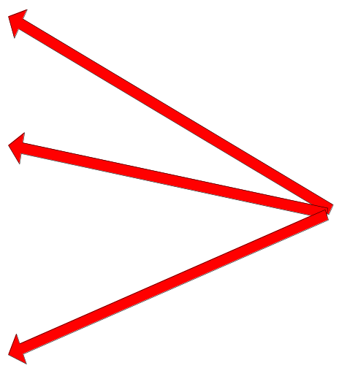
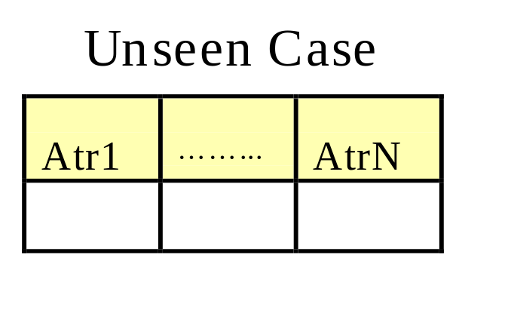
Instance-Based Classifiers
Store the training records
Use training records to
predict the class label of
unseen cases

Slide 35
Instance Based Classifiers
Examples:
  Rote-learner
    Memorizes entire training data and performs classification only if attributes of record match one of the training examples exactly
  Nearest neighbor
    Uses k “closest” points (nearest neighbors) for performing classification

Slide 36






Nearest Neighbor Classifiers
Basic idea:
  If it walks like a duck, quacks like a duck, then it’s probably a duck
Compute Distance
Test Record
Training Records
Choose k of the “nearest” records

Slide 37
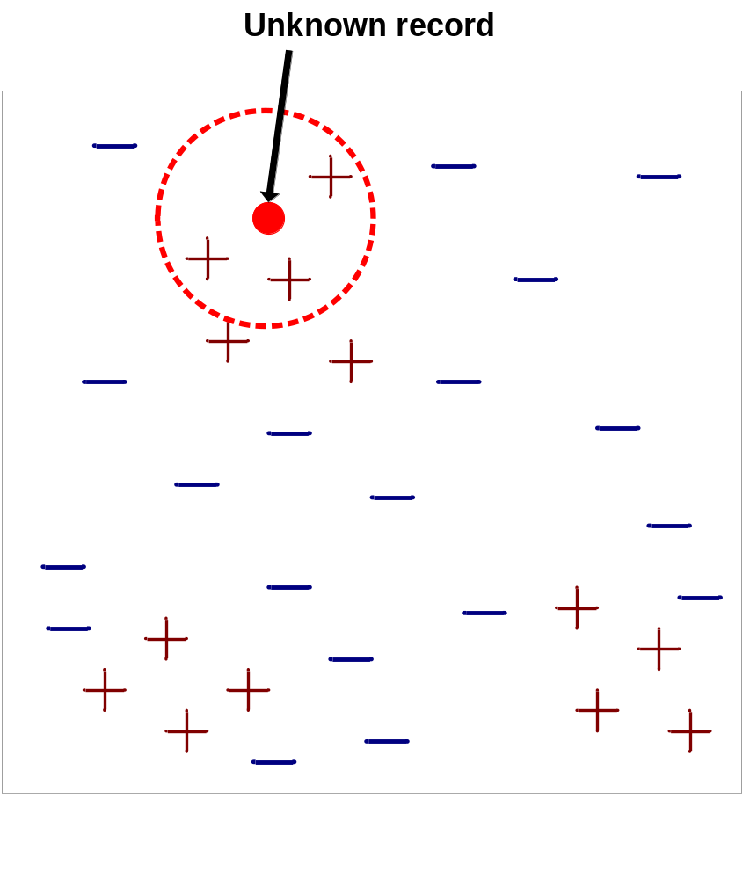
Nearest-Neighbor Classifiers
Requires three things
  The set of stored records
  Distance metric to compute distance between records
  The value of k, the number of nearest neighbors to retrieve
To classify an unknown record:
  Compute distance to other training records
  Identify k nearest neighbors
  Use class labels of nearest neighbors to determine the class label of unknown record (e.g., by taking majority vote)

Slide 38

Definition of Nearest Neighbor
K-nearest neighbors of a record x are data points that have the k smallest distance to x

Slide 39
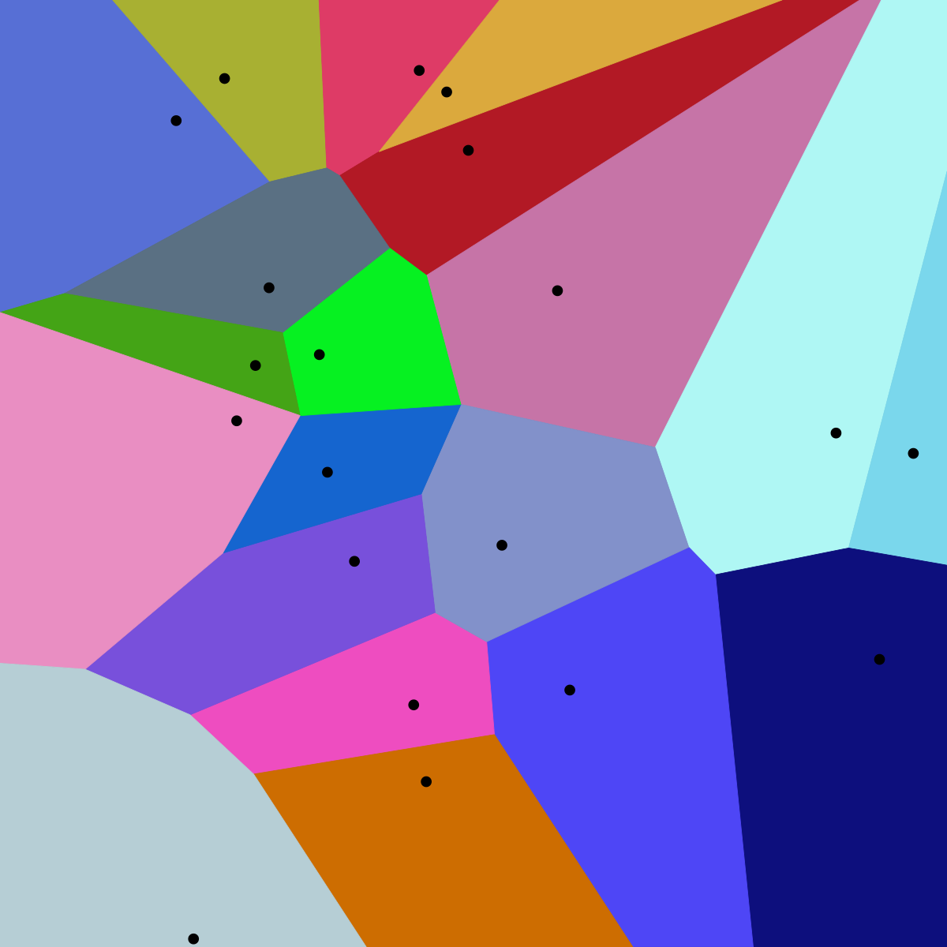
1 nearest-neighbor
Voronoi Diagram

Slide 40
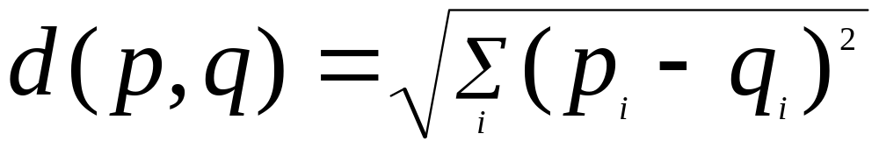
Nearest Neighbor Classification
Compute distance between two points:
  Example: Euclidean distance
Determine the class from nearest neighbor list
  take the majority vote of class labels among the k-nearest neighbors
  Weight the vote according to distance
    weight factor, w = 1/d²

Slide 41
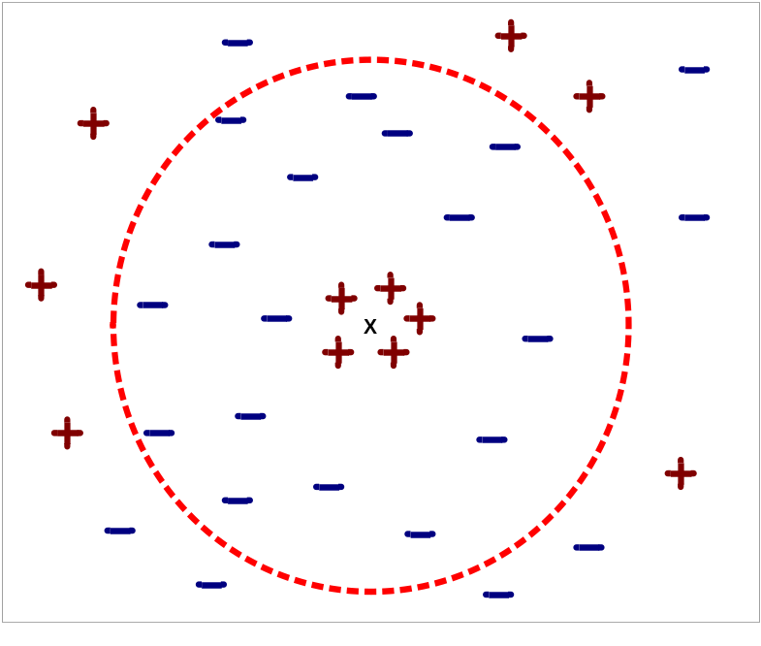
Nearest Neighbor Classification…
Choosing the value of k:
  If k is too small, sensitive to noise points
  If k is too large, neighborhood may include points from other classes

Slide 42
Nearest Neighbor Classification…
Scaling issues
  Attributes may have to be scaled to prevent distance measures from being dominated by one of the attributes
  Example:
    height of a person may vary from 1.5m to 1.8m
    weight of a person may vary from 90lb to 300lb
    income of a person may vary from $10K to $1M

Slide 43
Nearest Neighbor Classification…
Problem with Euclidean measure:
  High dimensional data
    curse of dimensionality
  Can produce counter-intuitive results
1 1 1 1 1 1 1 1 1 1 1 0
1 0 0 0 0 0 0 0 0 0 0 0
vs
0 1 1 1 1 1 1 1 1 1 1 1
0 0 0 0 0 0 0 0 0 0 0 1
d = 1.4142
d = 1.4142
    Solution: Normalize the vectors to unit length

Slide 44
Nearest neighbor Classification…
k-NN classifiers are lazy learners
  It does not build models explicitly
  Unlike eager learners such as decision tree induction and rule-based systems
  Classifying unknown records are relatively expensive

Slide 45
Classification: Alternative Techniques
Bayesian Classifiers

Slide 46
Classification: Alternative Techniques
Ensemble Methods

Slide 47
Ensemble Methods
Construct a set of classifiers from the training data
Predict class label of test records by combining the predictions made by multiple classifiers

Slide 48
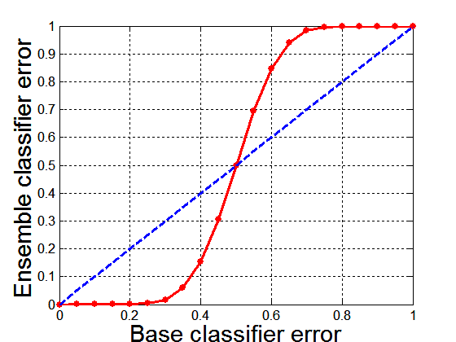
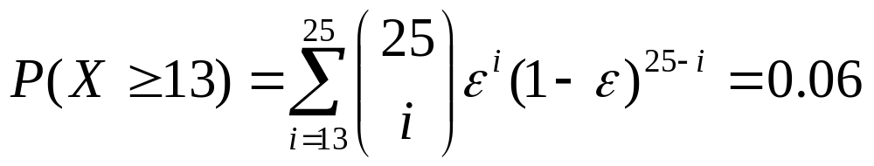
Why Ensemble Methods work?
Suppose there are 25 base classifiers
  Each classifier has
  error rate, ε = 0.35
  Assume errors made
  by classifiers are uncorrelated
  Probability that the ensemble classifier makes a wrong prediction:

Slide 49
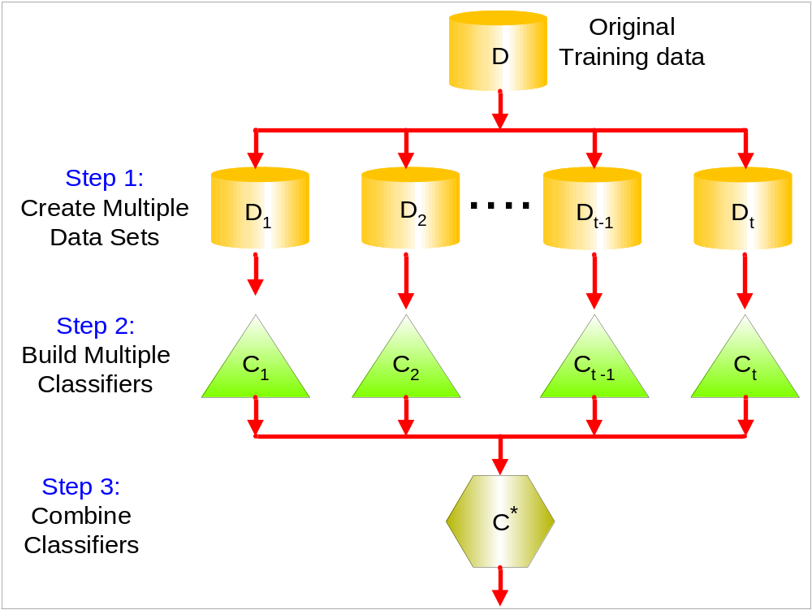
General Approach

Slide 50
Types of Ensemble Methods
Bayesian ensemble
  Example: Mixture of Gaussian
Manipulate data distribution
  Example: Resampling method
Manipulate input features
  Example: Feature subset selection
Manipulate class labels
  Example: error-correcting output coding
Introduce randomness into learning algorithm
  Example: Random forests

Slide 51
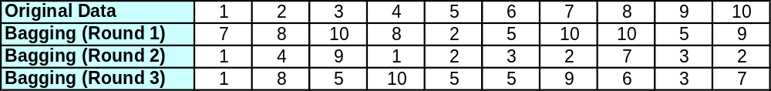
Bagging
Sampling with replacement
Build classifier on each bootstrap sample
Each sample has probability 1-(1 – 1/n)^{n} of being selected

Slide 52
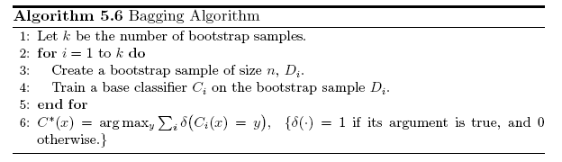
Bagging Algorithm

Slide 53
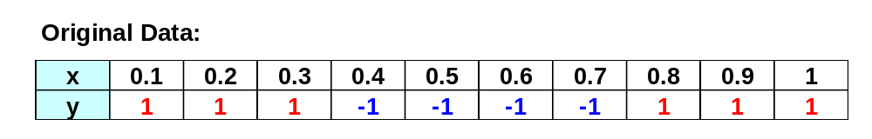
Bagging Example
Consider 1-dimensional data set:
Classifier is a decision stump
  Decision rule: x ≤ k versus x > k
  Split point k is chosen based on entropy
x ≤ k
True
False
y_{left}
y_{right}

Slide 54
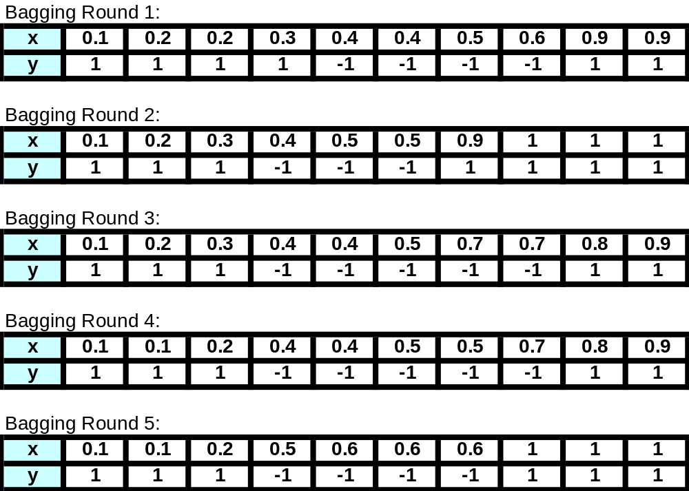
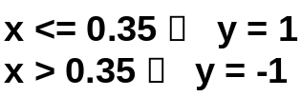
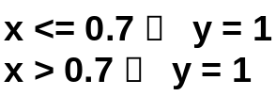
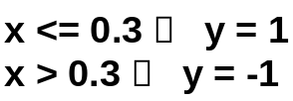
Bagging Example

Slide 55
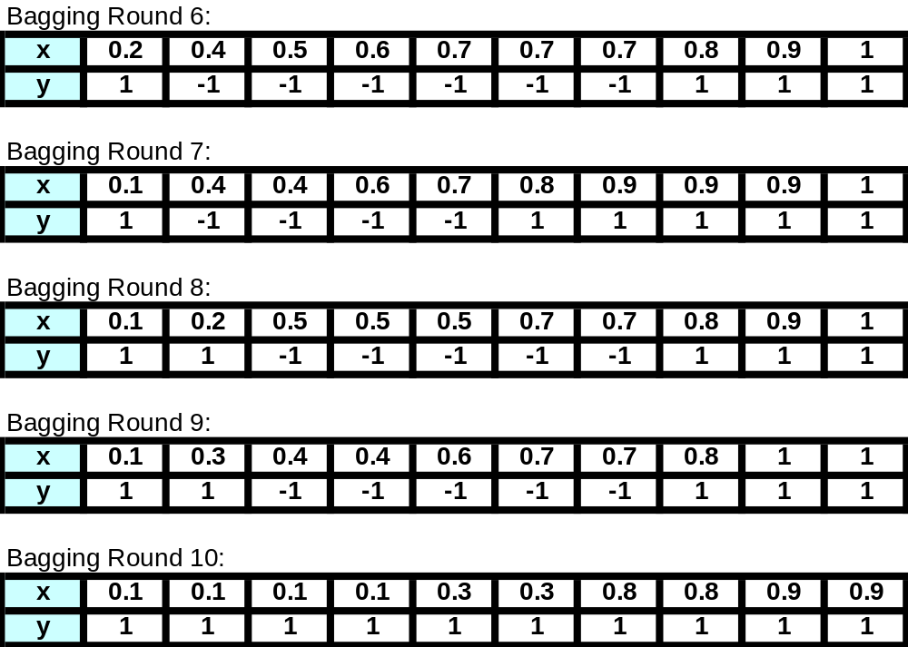
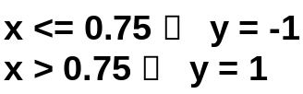
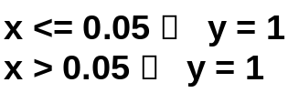
Bagging Example

Slide 56
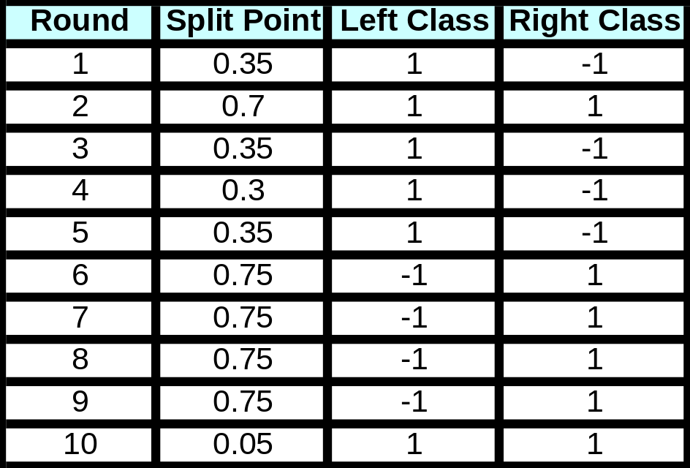
Bagging Example
Summary of Training sets:

Slide 57
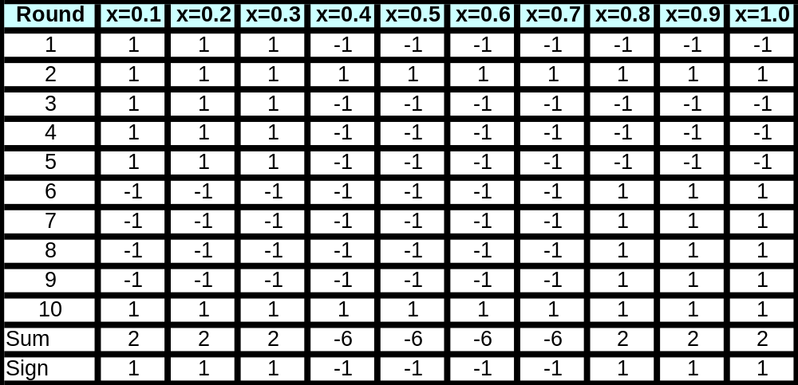
Bagging Example
Assume test set is the same as the original data
Use majority vote to determine class of ensemble classifier
Predicted Class

Slide 58
Boosting
An iterative procedure to adaptively change distribution of training data by focusing more on previously misclassified records
  Initially, all N records are assigned equal weights
  Unlike bagging, weights may change at the end of each boosting round

Slide 59
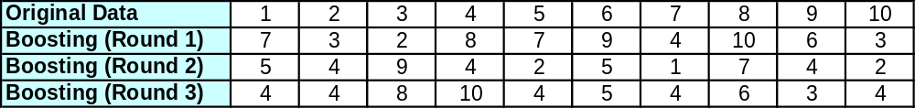
Boosting
Records that are wrongly classified will have their weights increased
Records that are classified correctly will have their weights decreased
Example 4 is hard to classify
Its weight is increased, therefore it is more likely to be chosen again in subsequent rounds

Slide 60
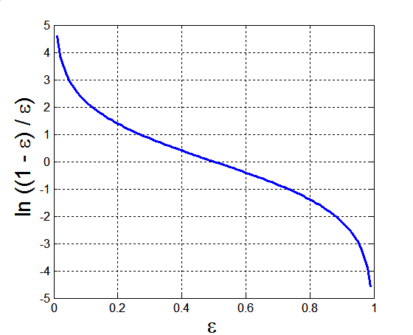
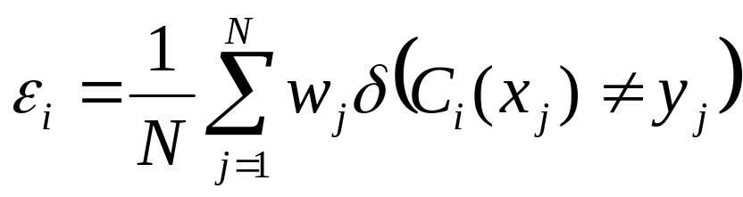
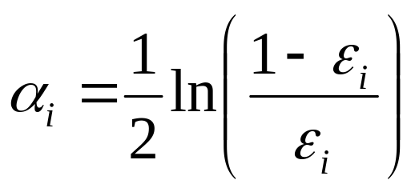
AdaBoost
Base classifiers: C₁, C₂, …, C_{T}
Error rate:
Importance of a classifier:

Slide 61
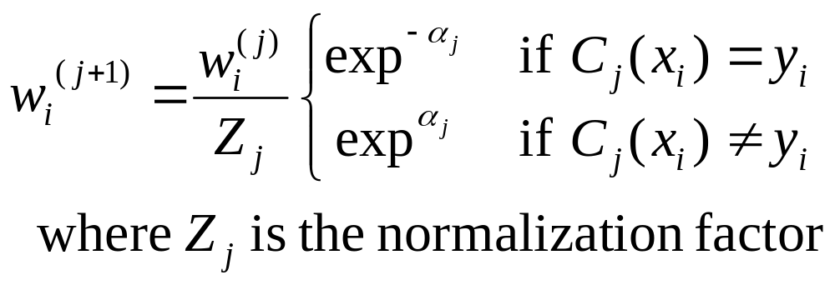
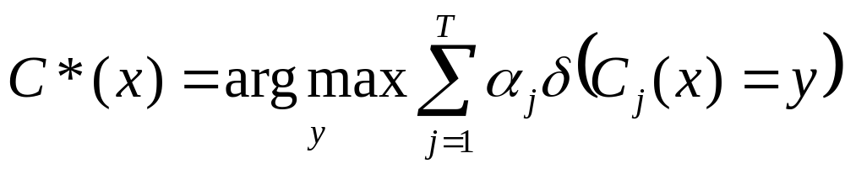
AdaBoost Algorithm
Weight update:
If any intermediate rounds produce error rate higher than 50%, the weights are reverted back to 1/n and the resampling procedure is repeated
Classification:

Slide 62
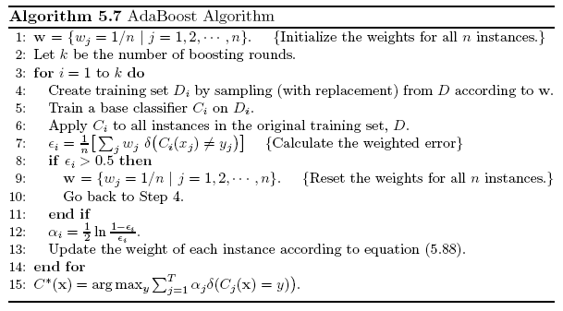
AdaBoost Algorithm

Slide 63
AdaBoost Example
Consider 1-dimensional data set:
Classifier is a decision stump
  Decision rule: x ≤ k versus x > k
  Split point k is chosen based on entropy
x ≤ k
True
False
y_{left}
y_{right}

Slide 64
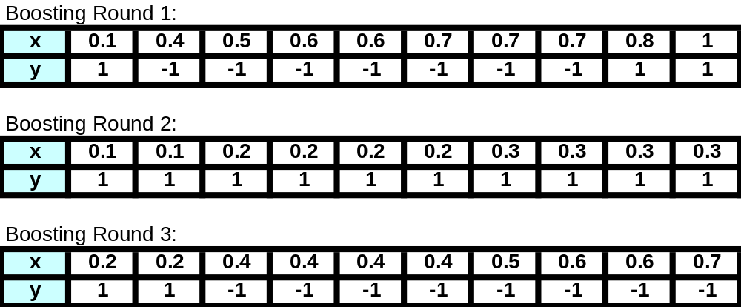

AdaBoost Example
Training sets for the first 3 boosting rounds:
Summary:

Slide 65


AdaBoost Example
Weights
Classification
Predicted Class

Slide 66
Classification: Alternative Techniques
Imbalanced Class Problem
Introduction to Data Mining 8/26/2005 <number>

Slide 67
Class Imbalance Problem
Lots of classification problems where the classes are skewed (more records from one class than another)
  Credit card fraud
  Intrusion detection
  Defective products in manufacturing assembly line

Slide 68
Challenges
Evaluation measures such as accuracy is not well-suited for imbalanced class
Detecting the rare class is like finding needle in a haystack

Slide 69
Confusion Matrix
Confusion Matrix:
 | PREDICTED CLASS
ACTUAL CLASS |  | Class=Yes | Class=No
 | Class=Yes | a (TP) | b (FN)
 | Class=No | c (FP) | d (TN)
a: TP (true positive)
b: FN (false negative)
c: FP (false positive)
d: TN (true negative)

Slide 70

Accuracy
Most widely-used metric:
 | PREDICTED CLASS
ACTUAL CLASS |  | Class=Yes | Class=No
 | Class=Yes | a (TP) | b (FN)
 | Class=No | c (FP) | d (TN)

Slide 71
Problem with Accuracy
Consider a 2-class problem
  Number of Class 0 examples = 9990
  Number of Class 1 examples = 10
If a model predicts everything to be class 0, accuracy is 9990/10000 = 99.9 %
  This is misleading because the model does not detect any class 1 example
  Detecting the rare class is usually more interesting (e.g., frauds, intrusions, defects, etc)

Slide 72

Alternative Measures
 | PREDICTED CLASS
ACTUAL CLASS |  | Class=Yes | Class=No
 | Class=Yes | a (TP) | b (FN)
 | Class=No | c (FP) | d (TN)

Slide 73

Alternative Measures

Slide 74
ROC (Receiver Operating Characteristic)
A graphical approach for displaying trade-off between detection rate and false alarm rate
Developed in 1950s for signal detection theory to analyze noisy signals
ROC curve plots TPR against FPR
  TPR = TP/(TP+FN), FPR = FP/(TN+FP)
  Performance of a model represented as a point in an ROC curve
  Changing the threshold parameter of classifier changes the location of the point

Slide 75

ROC Curve
(TPR,FPR):
(0,0): declare everything
to be negative class
(1,1): declare everything
to be positive class
(1,0): ideal
Diagonal line:
  Random guessing
  Below diagonal line:
    prediction is opposite of the true class

Slide 76
ROC (Receiver Operating Characteristic)
To draw ROC curve, classifier must produce continuous-valued output
  Outputs are used to rank test records, from the most likely positive class record to the least likely positive class record
Many classifiers produce only discrete outputs (i.e., predicted class)
  How to get continuous-valued outputs?
    Decision trees, rule-based classifiers, neural networks, Bayesian classifiers, k-nearest neighbors, SVM

Slide 77


Example: Decision Trees
Decision Tree
Continuous-valued outputs

Slide 78


ROC Curve Example

Slide 79

Using ROC for Model Comparison
No model consistently outperform the other
  M₁ is better for small FPR
  M₂ is better for large FPR
Area Under the ROC curve
  Ideal:
    Area = 1
  Random guess:
    Area = 0.5

Slide 80
How to Construct an ROC curve
Use classifier that produces continuous-valued output for each test instance score(+|A)
Sort the instances according to score(+|A) in decreasing order
Apply threshold at each unique value of score(+|A)
Count the number of TP, FP,
TN, FN at each threshold
  TPR = TP/(TP+FN)
  FPR = FP/(FP + TN)
Instance | score(+|A) | True Class
1 | 0.95 | +
2 | 0.93 | +
3 | 0.87 | -
4 | 0.85 | -
5 | 0.85 | -
6 | 0.85 | +
7 | 0.76 | -
8 | 0.53 | +
9 | 0.43 | -
10 | 0.25 | +

Slide 81


How to construct an ROC curve
Threshold >=
ROC Curve:

Slide 82
Handling Class Imbalanced Problem
Class-based ordering (e.g. RIPPER)
  Rules for rare class have higher priority
Cost-sensitive classification
  Misclassifying rare class as majority class is more expensive than misclassifying majority as rare class
Sampling-based approaches

Slide 83

Cost Matrix
 | PREDICTED CLASS
ACTUAL CLASS |  | Class=Yes | Class=No
 | Class=Yes | f(Yes, Yes) | f(Yes,No)
 | Class=No | f(No, Yes) | f(No, No)
C(i,j): Cost of misclassifying class i example as class j
Cost Matrix | PREDICTED CLASS
ACTUAL CLASS | C(i, j) | Class=Yes | Class=No
 | Class=Yes | C(Yes, Yes) | C(Yes, No)
 | Class=No | C(No, Yes) | C(No, No)

Slide 84
Computing Cost of Classification
Cost Matrix | PREDICTED CLASS
ACTUAL CLASS | C(i,j) | + | -
 | + | -1 | 100
 | - | 1 | 0
Model M₁ | PREDICTED CLASS
ACTUAL CLASS |  | + | -
 | + | 150 | 40
 | - | 60 | 250
Model M₂ | PREDICTED CLASS
ACTUAL CLASS |  | + | -
 | + | 250 | 45
 | - | 5 | 200
Accuracy = 80%
Cost = 3910
Accuracy = 90%
Cost = 4255

Slide 85

Cost Sensitive Classification
Example: Bayesian classifer
  Given a test record x:
    Compute p(i|x) for each class i
    Decision rule: classify node as class k if
  For 2-class, classify x as + if p(+|x) > p(-|x)
    This decision rule implicitly assumes that
    C(+|+) = C(-|-) = 0 and C(+|-) = C(-|+)

Slide 86


Cost Sensitive Classification
General decision rule:
  Classify test record x as class k if
2-class:
  Cost(+) = p(+|x) C(+,+) + p(-|x) C(-,+)
  Cost(-) = p(+|x) C(+,-) + p(-|x) C(-,-)
  Decision rule: classify x as + if Cost(+) < Cost(-)
    if C(+,+) = C(-,-) = 0:

Slide 87
Sampling-based Approaches
Modify the distribution of training data so that rare class is well-represented in training set
  Undersample the majority class
  Oversample the rare class
Advantages and disadvantages

Slide 88

DNN vs. GMM
Gaussian mixture models (GMM) for speech recognition
Table 1. Word error rate (WER) for three speech recognition tasks. GMM, Gaussian mixture models. DNN, deep neural nets. Data provided by Brian Kingsbury from IBM.

Slide 89

Big Data Learning
Deep Neural Networks
  5 to 7 hidden layers for a typical DNN for speech recognition, with about 1000 units per layer
  Tens of millions of parameters to be optimized
  Training requires up to 1000 hours, on the order of 100 million training examples, two weeks on a super machine.

Slide 90
Big Data Learning – Future Development
Large Scale
Stochasticity
Nonlinearity
Parallelism
Good Generalization
Good Interpretation if possible

